Slide 1
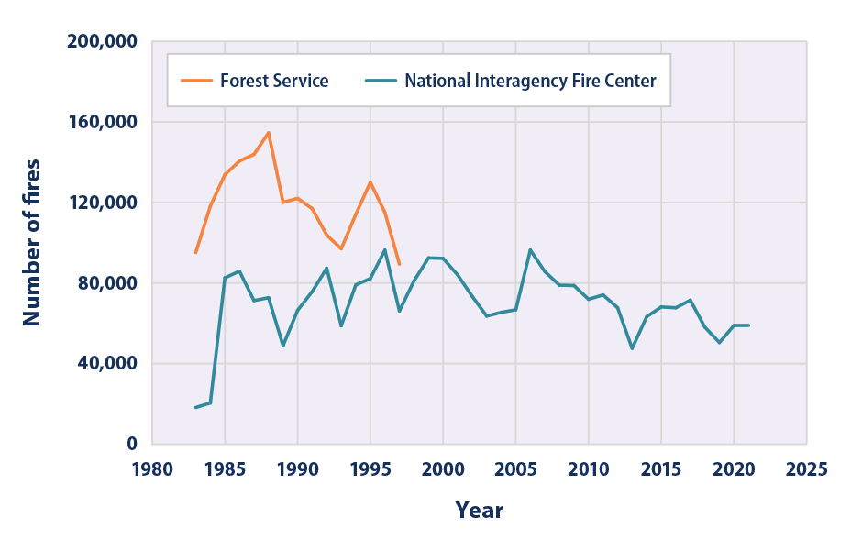
Wildfire Prediction Project Executive Summary
Overview
This project seeks to improve the predictability of wildfires which destroys an average of 7.4 million acres annually in the United States.
The Problem
Wildfires are a major concern for the National Parks Service. Each year millions of acres are destroyed. Firefighting resources are stretched thin. Additionally, recovery and rebuilding efforts cost communities millions of dollars.
How can we improve the ability to predict wildfires?
Can we better identify areas as higher risk?
The Solution
The National Parks Service has created a data team to improve the agency’s ability to predict wildfires through data analysis and machine learning.
Details
Keys to success
Data must be acquired in a timely manner from all service providers, regional forestry and governmental agencies.
The project created a national database of wildfire data that can be accessed and updated in real time by all agencies.
Project needs ongoing maintenance to improve prediction rates and data analysis.
Wildfire Frequency 1983-2021
Results Summary
The agency has set an internal goal for the wildfire predictive model of at least 90% accuracy. The team’s final model consistently met this goal when running data from previous years.
Reflections/
Next Steps
As a direct result of the wildfire project, the prior prediction system was improved by 35% in 2022.
The project is inspiring similar efforts in other parts of the world. The goal is to share prediction modeling and data.
Numerous courses used to train fire fighters, park rangers and national park employees are referencing the finds of this study.
Areas for clean up and controlled deforestation efforts are now identified.
Future results should continue the downward trend in destruction related to wildfires.

